Slide 1
Online course registration system (OCR)
Betina Driggers
CST 499 – Capstone for computer Software Technology
Dr. Charmelia Butler
October 17, 2025
Notes:
“Hello everyone, I’m Betina Driggers, and welcome to my final capstone project presentation for CST 499. Today I’ll walk you through my Online Course Registration System, developed with PHP and MySQL using the XAMPP stack.”

Slide 2
Project Overview
Goal: Develop a secure and scalable online course registration portal.
Technology Stack: PHP 8 and MySQL on XAMPP.
Components: Landing page, Login page, User Profile Registration page, and Course API.
Approach: SRS Analysis to build a UML design that guided the database build, frontend integration, and backend integration.
Notes:
The goal of the project was to develop a secure and scalable online course registration portal utilizing PHP 8 and MySQL on XAMPP. The portal needed to be able to allow a user to register, login, view their profile, and register for courses for the available semesters within the user’s profile. An SRS analysis was completed first and that was used to build a UML design which guided the remainder of the portal build from the database to the front and backend integrations as well as the user experience.

Slide 3
Software requirements specification (SRS)
Functional Requirements: Registration, login, authentication, and course management.
Non-Functional Requirements: Maintainability, performance, scalability, security, and usability.
System Actors: Admin, staff, and students.
Dependencies: PHP, MySQL, Bootstrap, and AJAX.
Notes:
The system’s software requirements specified both functional and non-functional needs. Functionally, the system supports user registration, login, and course management. Non-functional goals included security, scalability, usability, and maintainability.

Slide 4
UML Design Model
Use Case Diagram: Profile registration, user login, add/drop course, and view schedule.
Class Diagram: User, course, and enrollment entities with relationships.
Sequence Diagram: Registration flow that goes from the form to the process, then to the database, and finally to a commit.
Modular object-oriented PHP code structure.
Notes:
The UML diagrams illustrate how students interact with the system. The use case diagram covers login, register, and course enrollment. The class diagram shows User, Course, and Enrollment entities linked through foreign keys.

Slide 5
Landing and login pages
Landing Page (Master.php): Bootstrap layout with necessary navigation links.
Login Page: User authentication utilizing hashed password verification.
Session Management: Validation via role-based access.
User Interface (UI) Principles: Responsive design with a clear navigation structure (Tsui et al., 2018).
Notes:
The landing page serves as the portal’s home, while the login page authenticates users through secure password hashing. A Bootstrap layout keeps the interface clean and responsive.

Slide 6
Registration and Enrollment pages
Register.php: Frontend HTML form with Bootstrap styling and input validation.
Registration_Process.php: Server-side validation and data input using prepared statements (PHP, 2019).
Profile.php: Displays student data, course information, current course registrations (up to three semesters), current course waitlist, and course credit information.
AJAX integration updates enrollment/waitlist data without needing to reload the page.
Notes:
The registration page collects student data and uses server-side validation to ensure data integrity. The Profile page uses AJAX calls to fetch and update data dynamically, showing enrolled courses and credits in real time.

Slide 7
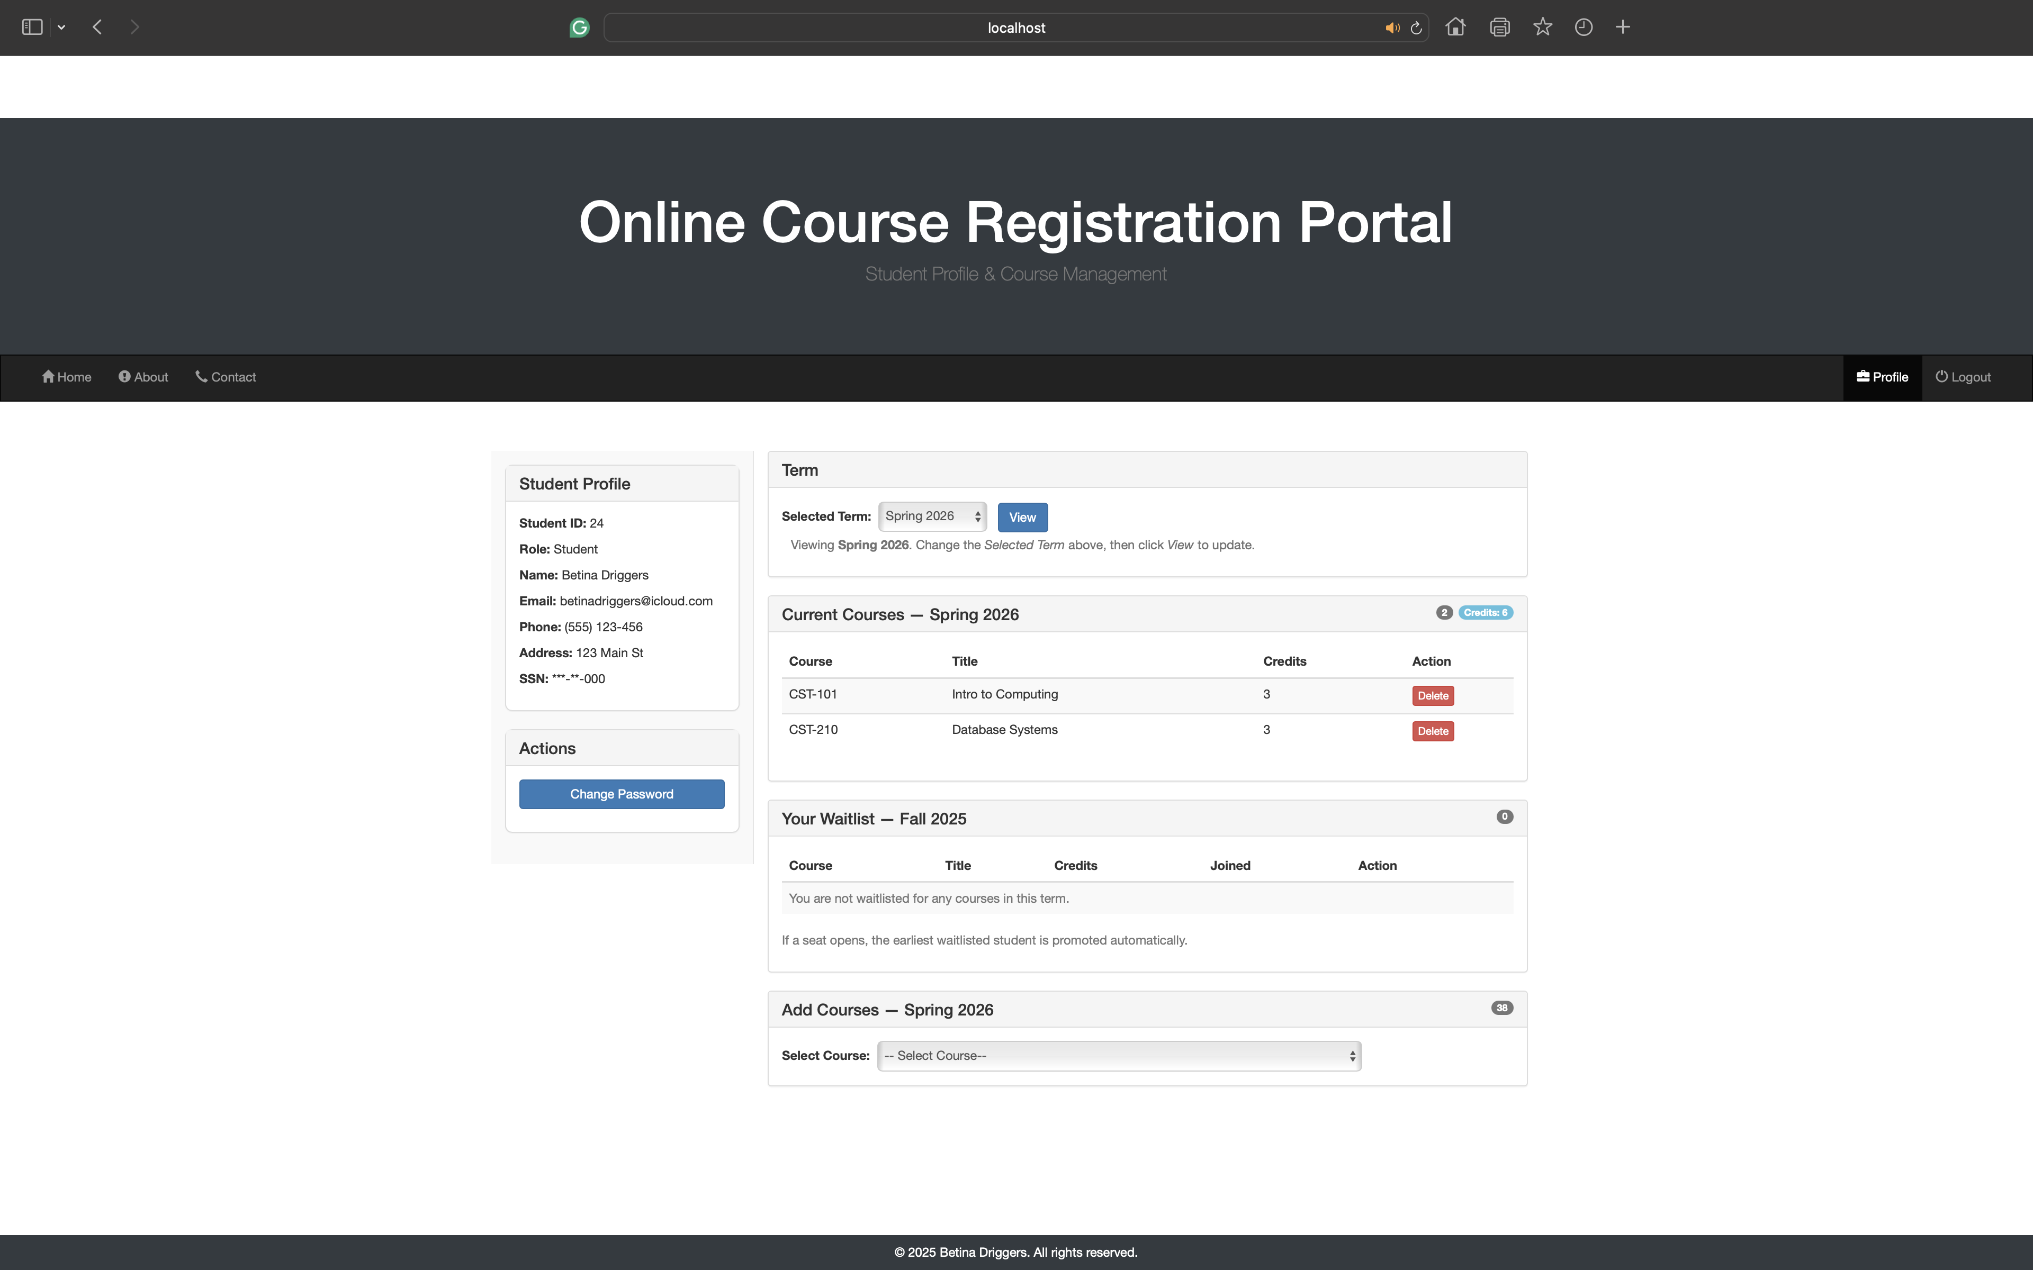
Profile Page Example
Notes:
This is an example of a user’s profile page who has courses registered for the selected semester of Spring 2026. As you can see the student’s profile information is on the left panel while the course information and registration options utilize the majority of the layout.

Slide 8
MySQL database design
Tables: tblUser, tblCourse, and tblEnrollment
Utilizes InnoDB with primary and foreign keys for integrity (Codd, 1970).
A normalized schema prevents data redundancy and anomalies.
SQL constraints manage course capacity and waitlist logic.
Notes:
The MySQL database contains three main tables: tblUser, tblCourse, and tblEnrollment. These are linked by foreign keys to preserve referential integrity (Codd, 1970). Normalization reduces redundancy and ensures data accuracy.

Slide 9
Database Integration and Security
CR_DB_Conn_Class.php: Centralized connection class for mysqli.
Uses prepared statements and error handling.
SQL injection is prevented by using parameter binding (PHP, 2019).
Utilizes secure coding practices.
Notes:
The CR_DB_Conn_Class.php script manages the database connection. It implements prepared statements and parameter binding to prevent SQL injection. Errors are handled gracefully with try-catch logic.

Slide 10
Course API and ajax flows
Courses_API.php: JSON API that enables the Add, Drop, and Waitlist operations simultaneously.
Improves UI experience as page reloads are not utilized.
Highlights RESTful architecture principles (Tsui et al., 2018).
Notes:
The Courses_API.php file connects the frontend and backend. Through AJAX calls, students can add, drop, or waitlist classes without reloading the page, delivering a smooth user experience.

Slide 11
Key Lessons and Challenges
Importance of schema integrity and foreign keys (Codd, 1970).
Security through prepared statements (PHP, 2019).
Efficient simultaneous updates using AJAX (MySQL, 2019).
Emphasis on maintainability, scalability, and code readability Tsui et al., 2018).
Notes:
I learned that database integrity is key to system stability. Prepared statements simplify security reviews. Using a central API also improves performance and reduces race conditions.

Slide 12
Conclusion
The OCR system achieves secure registration and data management.
Combines UML, PHP, and MySQL to build a cohesive application.
Demonstrates software engineering principles that include maintainability, scalability, security, and usability.
Notes:
In summary, the OCR system demonstrates how PHP and MySQL can be used to create a secure, scalable web application. By following sound software engineering principles, the project achieves a reliable and maintainable solution for course registration.

Slide 13
references
Codd, E. F. (1970). A relational model of data for large shared data banks. Communications of the ACM, 13(6), 377–387. https://doi.org/10.1145/362384.362685
MySQL. (2019). MySQL :: MySQL Documentation. Mysql.com. https://dev.mysql.com/doc/
PHP. (2019). PHP: Prepared Statements - Manual. Php.net. https://www.php.net/manual/en/mysqli.quickstart.prepared-statements.php
Tsui, F., Karam, O., & Bernal, B. (2018). Essentials of software engineering (4th ed.). Jones & Bartlett Learning.
Notes:
Thank you for watching. This slide contains the references used within the Power Point Presentation.

